Slide 1
New Jersey Offshore Wind Transmission State Agreement Approach Environmental and Permitting Issues
In the Matter of Declaring Transmission To Support Offshore Wind a Public Policy of the State of New Jersey
Docket number QO20100630

Slide 2
Environmental and Permitting Issues
Potential impacts that SAA projects may have on wildlife, recreational and commercial fisheries, and natural resources.
Potential issues with federal, state and local permitting.
Notes:
The topic for today’s meeting is exploring the potential impacts that SAA projects may have on wildlife, recreational and commercial fisheries, and natural resources. And secondly, the potential issues with federal, state and local permitting.
So, let’s take a step back to see how we got here.

Slide 3
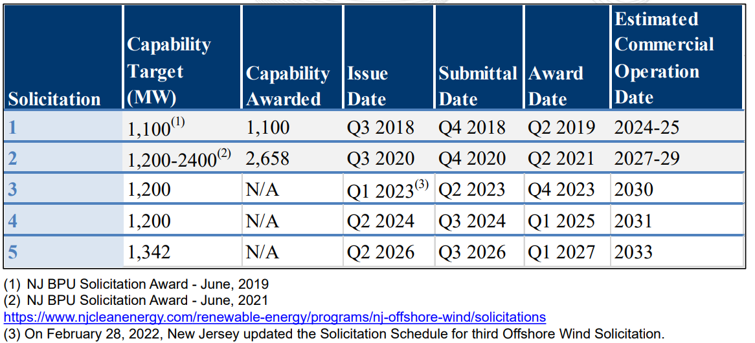
NJ Offshore Wind Generation Solicitation Schedule
Notes:
Governor Murphy set a goal of achieving 7,500 MW of offshore wind generation by 2035 via Executive Order No. 92.
The Board issued its first offshore wind solicitation in 2018, with an 1,100 MW award.
When issued, this solicitation was the largest in the country and represented a very large step in achieving the State’s ambitious renewable energy goals.
In 2020, Board issued a second solicitation which resulted in two more offshore wind projects being awarded, totaling more than 2,600 MWs.
3 more solicitations are scheduled to occur in order to meet the 7,500 MW goal.

Slide 4
NJ Offshore Wind Transmission
PJM Interconnection is New Jersey’s regional grid operator
BPU identified the potential benefits of soliciting coordinated market-based options for building out the transmission facilities necessary to achieve this goal
In its November 2020 order, BPU requested PJM to solicit competitive transmission proposals for New Jersey via the State Agreement Approach (SAA)
Notes:
How do you deliver the electricity generated by the offshore wind farms to New Jersey residents?
Through an offshore wind transmission system, which simply means the delivery of electricity from the offshore wind turbines to the local distribution system, onshore.
Thus far under the first two solicitations, each project proposed to bring the electricity onshore from their individual project. You can see how this may result in inefficiencies, particularly as new wind farms are added.
In New Jersey and other Mid-Atlantic states, the transmission planning process is based on a detailed set of rules, approved by the Federal Energy Regulatory Commission and implemented by the regional grid operator PJM Interconnection (“PJM”). These rules determine how and when to expand and enhance the regional grid, and outline a highly competitive, robust procurement structure to select which projects get built.
To position the state to reach Governor Phil Murphy’s ambitious goal of 7,500 megawatts of offshore wind energy by 2035, the NJBPU has formally requested inclusion of its offshore wind public policy into the regional transmission expansion analysis at PJM.
This competitive solicitation process is known as the State Agreement Approach (SAA).

Slide 5
PJM State Agreement Approach
In compliance with FERC Order No. 1000, PJM developed the SAA to provide for the consideration of transmission needs driven by Public Policy Requirements in the regional transmission planning processes, known at its Regional Transmission Expansion Plan (RTEP)
The SAA allows state governmental entities authorized by their respective states to be responsible, voluntarily, for the allocation of costs of a proposed transmission expansion or enhancement that addresses state public policy requirements that the applicable state(s) in the PJM Region have identified or accepted
Notes:
The SAA is a tool offered by PJM for its member states to request transmission development needs, based on policy requirements, that PJM will incorporate in the RTEP process.
New Jersey is the first state to utilize the SAA
By initiating a competitive solicitation for transmission projects from a broad pool of regional developers, NJBPU is ensuring that New Jersey can select from the most efficient and effective options available on the market in pursuit of a coordinated transmission solution for delivering offshore wind.
PJM’s robust competitive bidding process forces developers to propose lower costs and innovative proposals resulting in efficiencies and ratepayer savings. Opening the proposal window to all qualified PJM developers allow for a diversity of approaches and expertise that identifies an optimal grid with high benefits and low environmental impact.

Slide 6
2021 SAA to Support NJ Offshore Wind
PJM with BPU Staff developed a solicitation for electric transmission project applications under the SAA to meet New Jersey’s public policy
Window Opened: April 15, 2021
Window Closed: September 17, 2021
The solicitation requested Applications for four distinct options shown on the next slide, with each entity having the choice to propose more than one option
PJM received Applications from 13 entities proposing a total of 80 projects
Notes:
PJM with BPU Staff developed a solicitation for electric transmission project applications under the SAA to meet New Jersey’s public policy
Window Opened: April 15, 2021
Window Closed: September 17, 2021
The solicitation requested Applications for four distinct options shown on the next slide, with each entity having the choice to propose more than one option
PJM received Applications from 13 entities proposing a total of 80 projects
Under the SAA, the BPU is the ultimate decision-maker, deciding which, if any, of the proposals proceed to construction. These projects are not likely to be pursued if they do not result in development of a lower cost, lower risk, or higher benefit option for the interconnection and delivery of New Jersey’s offshore wind.
The BPU may decide to terminate the SAA process, if it is in the best interest of the State. NJBPU Staff continues to work with PJM to develop adequate ratepayer protections should any transmission project eventually be selected through the SAA.

Slide 7
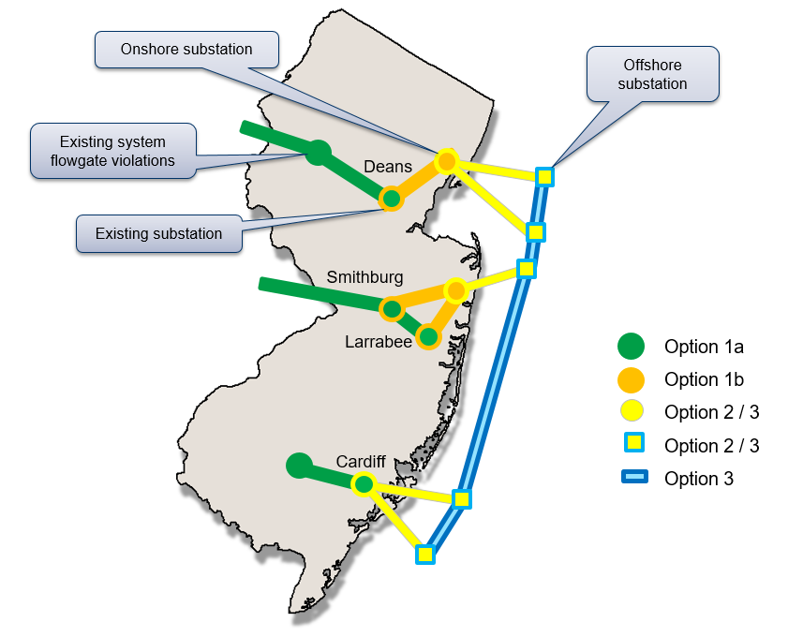
Notes:
The SAA solicitation identifies four interrelated components of an open access offshore wind transmission facility that may be part of an optimal solution.
1) The first component (“Option 1a”) focuses on potential upgrades to the existing grid that may be necessary for offshore wind energy injections. Staff and PJM conducted an analysis, prior to releasing the solicitation, which identified four default injection locations, on the onshore grid, for the interconnection of potential solutions. Developers retain flexibility to propose alternate interconnection locations if they identify more beneficial interconnection locations.
2) The second component (“Option 1b”) requests developers to submit proposals for extending the onshore transmission grid closer to the shore, creating so-called “power corridors.” These corridors would serve to extend the onshore high-voltage transmission system closer to the shoreline, providing planned landfall locations to optimize efficiency and minimize environmental disturbances.
3) The third component (“Option 2”) extends the power corridor concept into the water, providing a potential interconnection location for offshore wind that is closer to the turbines.
4) The fourth component (“Option 3”) requests developers to submit proposals for possible interconnections between offshore substations, referred to as an offshore transmission “backbone.” Option 3 proposals allow developers to demonstrate the benefits of a networked grid that may connect various lease areas or other offshore transmission infrastructure.

Slide 8
SAA Evaluation Process
BPU Staff is currently working with PJM to evaluate the SAA proposals
PJM and BPU Staff are also evaluating project costs, constructability, risk mitigation, environmental impacts, permitting plan, quality of proposal and developer experience, flexibility, modularity, and option value, and additional New Jersey benefits
Notes:
Board Staff is now evaluating those projects, in close coordination with PJM, and the Board may select the best project or projects, or may select no projects.
We are here to collectively and transparently guide the evaluation process. The Board has engaged the professional consulting firm The Brattle Group through a competitive solicitation to assist us in this crucial work and to help us facilitate a meaningful stakeholder involvement.
The BPU team strongly invites and encourages your active participation and insights.
With that, I’d like to introduce you to our moderator today, my colleague Kira Lawrence. Kira is a climate scientist and oceanographer. She received her PhD from Brown, her masters Brown and UC Santa Cruz, and her undergraduate degree from Dartmouth, all in Earth Sciences. She’s spent much of her career in academia but has also worked at the Woodwell Climate Research Center.

Slide 9
Environmental and Permitting Issues
Topics for today’s discussion:
1. BOEM regulatory process
2. NJ State regulatory review process
3. Impacts on natural resources (e.g. fish, wildlife, habitat)
4. Potential for SAA to mitigate environmental impacts, e.g.:
Reduce the number of cables and landfalls
Evaluate options for landfalls and cable routes
Evaluate siting of infrastructure and ties into existing infrastructure
Notes:
Critical to the process is how potential SAA projects will address environmental impacts and permitting.
Our panel today will review the regulatory process and discuss impacts on natural resources and explore the potential benefits of a coordinated approach in mitigating some of the core environmental concerns associated with OSW.
By utilizing the SAA, New Jersey is positioned to minimize the number of transmission cables and cable landfall impacts through a coordinate approach. SAA also enables the avoidance of sensitive habitats,

Slide 10
Environmental and Permitting Issues
Topics for Today’s Discussion (continued):
5. Location of SAA facilities
6. Cumulative impacts of OSW transmission
7. Others
Notes:
The location of SAA facilities will impact how future OSW generation projects interconnect to them and their environmental footprint.
We’ll discuss how a coordinated approach affords insight into the cumulative impacts of OSW transmission.
We invite stakeholders to provide their questions and feedback on these and other environmental and permitting topics related to the SAA.
I look forward to our discussion and feedback from stakeholders.
And with that, I’ll welcome our first speaker.

Slide 11
Offshore Wind Transmission Framework
April 4, 2022
Josh Gange, Office of Renewable Energy Programs

Slide 12
Federal Regulatory Framework
Under OCSLA §1337(p)(1)(C), the Secretary may grant a lease, easement, or ROW on the OCS for activities that produce or support production, transportation, or transmission of energy sources other than oil and gas.
§585.104 states that except as otherwise authorized by law, it will be unlawful for any person to construct, operate, or maintain any facility to produce, transport, or support generation of electricity or other energy product derived from a renewable energy resource on any part of the OCS, except under and in accordance with the terms of a lease, easement, or ROW issued pursuant to the OCS Lands Act.

Slide 13
Roles in Transmission Planning
Federal Government
BOEM
FERC
Permitting Agencies – Natural Resources, etc.
Grid Operators
Independent System Operators/Regional Transmission Operators
State Role
Renewable Energy Goals/Legislation
Conditions in Offtake Agreements
State Utilities
Property Interests in Landfall Connection Points

Slide 14
Two Paths
Transmission as part of an offshore wind lease
585.200(b) - a lease confers the right to one or more project easements without further competition for transmission
Transmission under a Right of Way Grant
585.300 - an ROW grant authorizes the holder to install on the OCS cables, pipelines, and associated facilities that involve the transportation or transmission of electricity or other energy product from renewable energy projects.

Slide 15
Transmission as Part of a Lease
A lessee negotiates with state entities and utilities to determine appropriate landfall and grid connections points
Grid connection study with the appropriate ISO
BOEM does not have jurisdiction over landfall sites, nor state waters
An easement to shore is granted with a lease
The details of the easement(s) are provided as part of the COP
Easement may be presented in COP as options under a Project Design Envelope
Allows for more than one option to be considered

Slide 16
Right of Way Grant Process
OCSLA requires a competitive process unless BOEM determines there is competitive interest (585.307)
BOEM likely issues a Request for Competitive Interest
Also solicits information about the area proposed
If competition exists, BOEM will utilize a competitive process to award the ROW Grant (e.g., auction)
BOEM will conduct an environmental analysis and assess multiple use conflicts prior to making a decision on whether to issue a ROW Grant

Slide 17
ROW Process Continued
The Grant holder will propose the project within one year of issuance of the ROW in the form of a General Activities Plan (GAP)
Grantee conducts survey work to identify any hazards, cultural resources, and to optimize the route
Discusses methods and equipment to be utilized
The GAP will trigger additional NEPA process and consultations with other agencies prior to any approval and installation, or denial

Slide 18
Regional Transmission Options
Likely proposed under a ROW Grant
BOEM would analyze the impacts of any proposed system through the NEPA process
BOEM is likely unable to require use of an unbuilt system
A lessee proposing to use a regional transmission system could be granted an easement to the system
A state could mandate use of such a system through an offtake mechanism

Slide 19
ROW Details
Any ROW Grant holder must first be qualified by BOEM
An ROW is 200 ft in width centered on the cable
Greater widths available for demonstrated safety or environmental issues
A Grant does not prevent the granting of other rights by the US either before or after issuance
Activities may not unreasonably interfere with other approved activities or existing operations
The holder agrees that other users may use or occupy any part of the ROW not actually used
BOEM requires financial assurance for decommissioning

Slide 20
Josh Gange, Office of Renewable Energy Programs

Slide 21
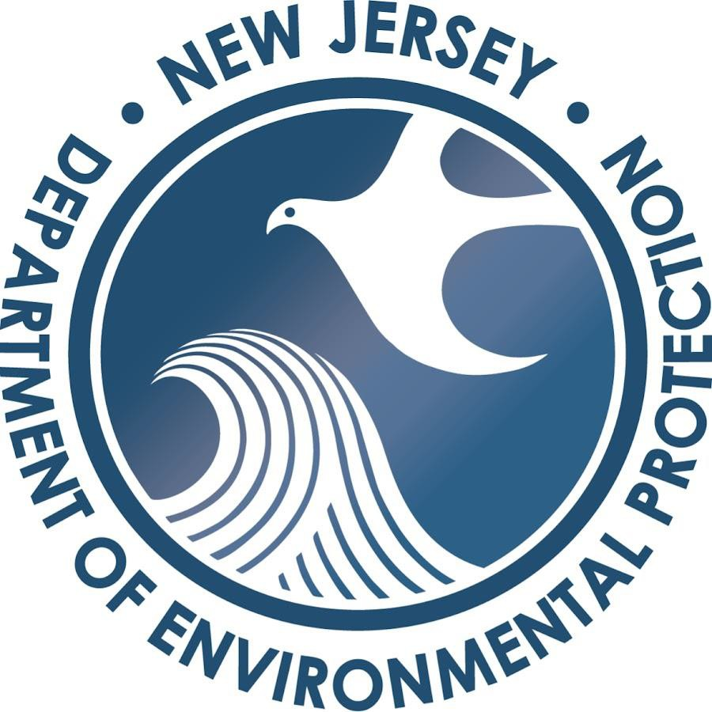
OFFSHORE WIND TRANSMISSION STATE AGREEMENT APPROACH
Megan Brunatti Deputy Chief of Staff

Slide 22
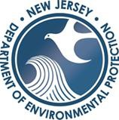
FINDING THE BALANCE
As the State pursues the responsible development of OSW, the NJDEP is obligated, pursuant to the federal Coastal Zone Management Act, 16 U.S.C. § 1451, et seq., and related state laws, to preserve, protect, restore, and enhance the resources of the State’s coastal zone.

Slide 23
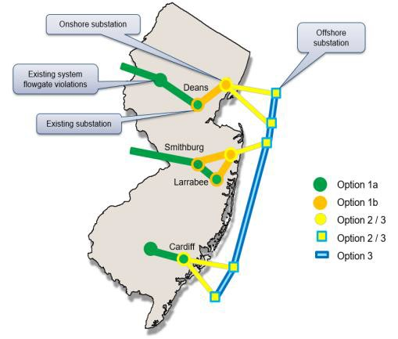
DEP’S GOALS IN THE SAA
DEP would like to see projects that minimize the amount of infrastructure built while also providing a reliable solution that meets PJM requirements and the State of New Jersey’s needs.
Routes proposed within existing road and transmission line corridors to the extent possible.
Avoid beach crossings and cable routes through back bays and sensitive coastal areas.
Minimize the number of radial lines.

Slide 24
EARLY COORDINATION
Developers were required to schedule a pre-application meeting with DEP’s Office of Permitting and Project Navigation.
Allowed an opportunity to review proposals prior to submittal and provide feedback on environmental impacts and permitting.

Slide 25
Through the SAA application process, applicants were required to submit an Environmental Protection Plan that describes all associated onshore and/or offshore environmental impacts from the planning, construction, and operation phases of the project.
ENVIRONMENTAL PROTECTION PLAN

Slide 26
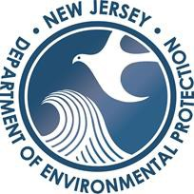
Through the SAA application process, applicants were required to submit a Fisheries Protection Plan that describes the specific measures the Applicant will take to avoid, minimize, and/or mitigate potential impacts on fish, and on commercial and recreational fisheries.
FISHERIES PROTECTION PLAN

Slide 27
Includes all local, State and/or Federal permits and/or approvals required to build and operate the Project.
Anticipated environmental benefit of a particular transmission proposal in comparison to radial lines.
Description of how the project will identify (or has identified) environmental and fisheries stakeholders, and how the applicant proposes to communicate with those stakeholders during preconstruction activities through project close out.
PERMITTING PLAN AND STAKEHOLDER OUTREACH

Slide 28
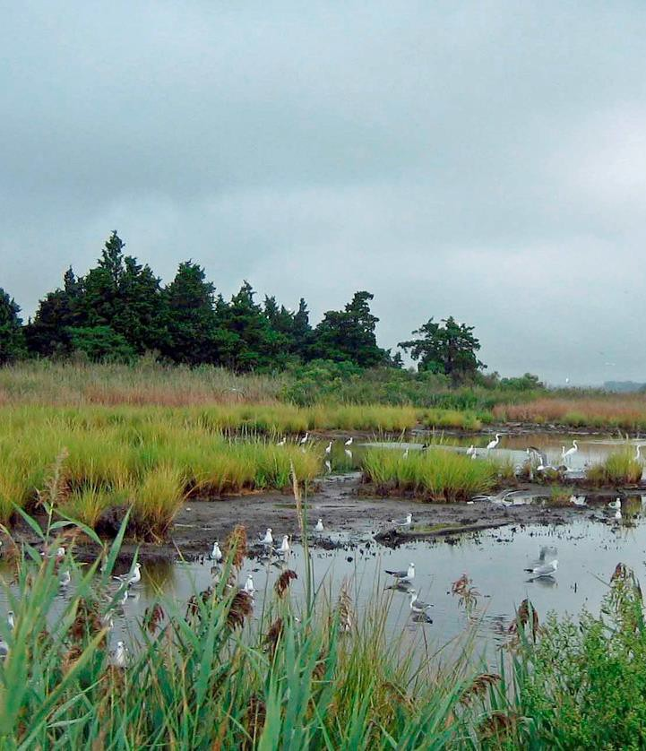
DEP’S EVALUATION
Coastal Lands
Aquatic and Benthic Species and Vegetation
Coastal Wetlands and Freshwater Wetlands
Riparian Zones
T&E species habitat
Fish and fisheries
Marine mammals, Sea Turtles
Birds, Bats
Water Quality
Air Quality
Encumbered lands
Historic and archaeologic resources

Slide 29
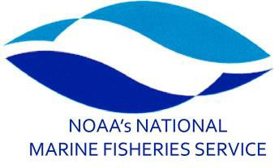
COORDINATION WITH STATE AND FEDERAL PARTNERS

Slide 30
THANK YOU!
NJDEP Offshore Wind

Slide 31
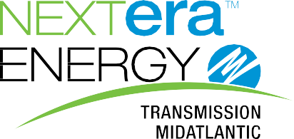
Offshore Wind Transmission Meeting #3
Michael Sole
Vice President, Environmental Services
NextEra Energy
April 4, 2022
1

Slide 32
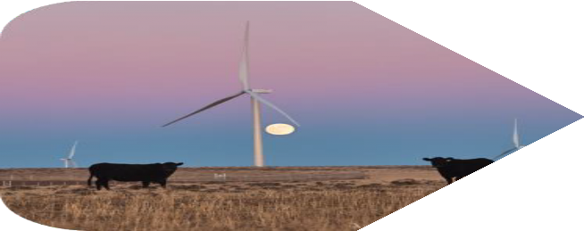
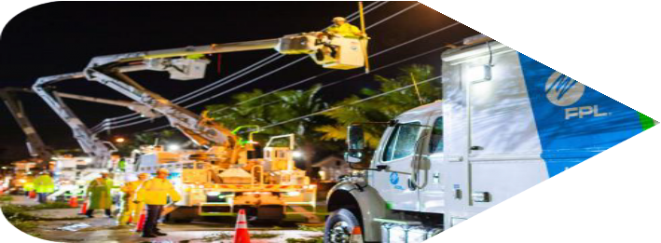
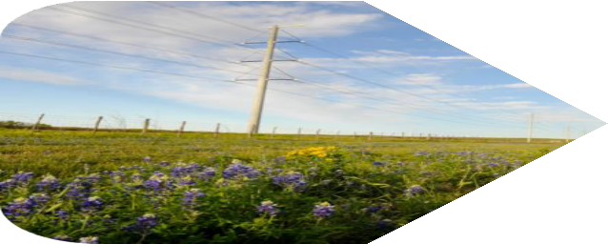
NextEra is a leader in the decarbonization of America
We are the world’s #1 producer of clean energy from the wind and sun
World’s #1 generator of wind and solar energy
5th largest
capital investor in the United States
~ 100 Years
of experience delivering power to coastal communities
+ 14,700 employees and $4.3 billion in annual payroll
87,610 miles
of Transmission &
Distribution lines
Proprietary & Confidential

Slide 33
NextEra’s dedication to environmental stewardship stems from our operational history nationwide as well as in sensitive coastal ecosystems
Proprietary & Confidential

Slide 34
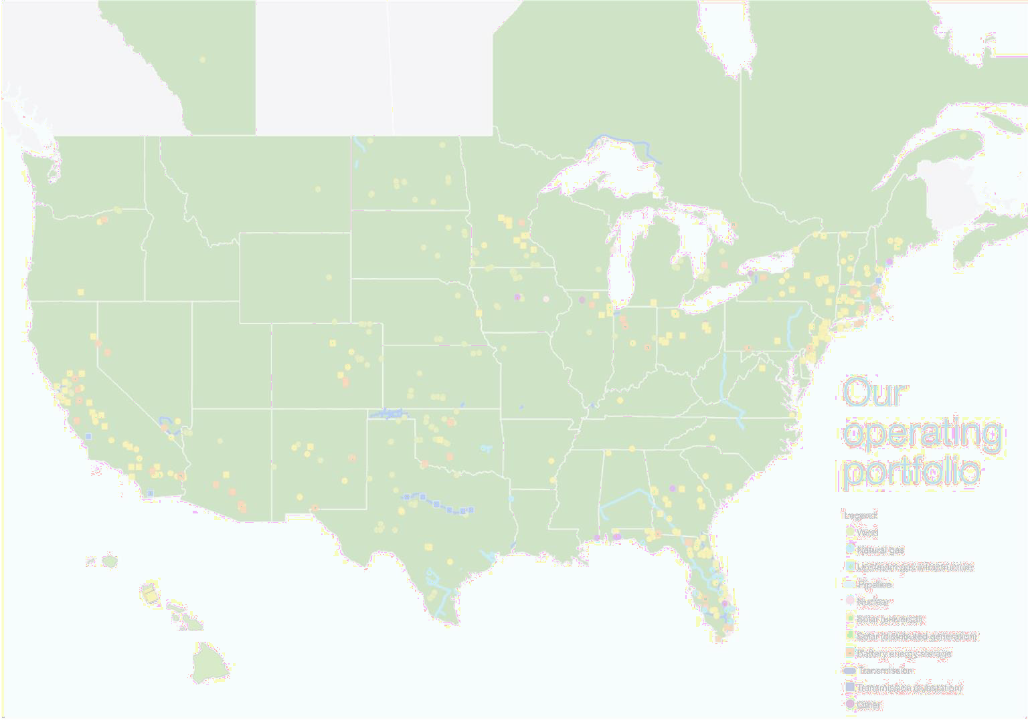
NextEra has done environmental analyses and permitting on a vast range of renewable energy projects throughout the country
Over 140 wind projects (> 20,000 MW) permitted; includes significant transmission gen-ties on most projects
Over 200 DG solar projects (> 500 MW) and over 90 large scale solar projects (> 4000 MW) permitted; includes moderate transmission tie lines
Over 15 wind/solar/battery projects and corresponding transmission tie lines permitted and constructed on federal land (Bureau of Land Management) requiring NEPA analyses
Several current development projects in NEPA with other federal agencies including Bureau of Indian Affairs, Bureau of Reclamation, US Forest Service, US Army Corps of Engineers, NRCS, WAPA, TVA and USDA-RUS
Coordinate NEPA with state environmental processes and public utility commission siting processes on renewable projects throughout the country
Proprietary & Confidential

Slide 35
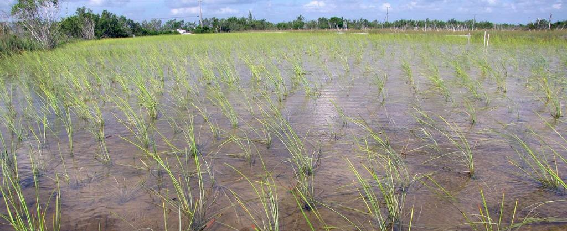
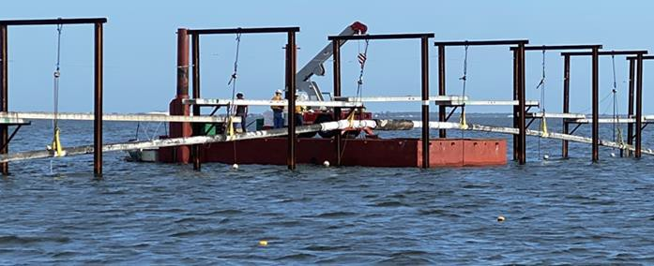
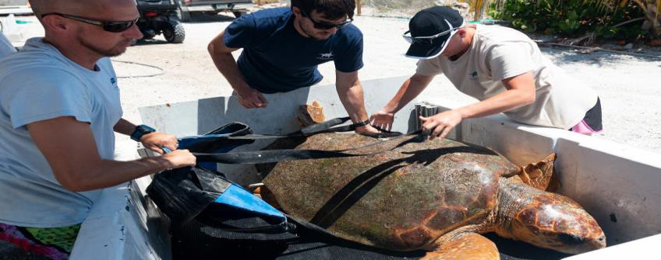
development to avoid and minimize impacts
Environmental impacts offshore and onshore will be addressed during project
Minimizing Impacts/Balancing Area Uses with Proposed Route
Initial project routing and siting process based on:
Consultation with local, state and federal agencies
Existing BOEM and New Jersey environmental analysis
Known time of year restrictions for marine species (fish/crab/whales), avian and other upland wildlife
Fisheries Protection Plan
Maximize use of existing ROW and previously disturbed areas
Next Steps
Site specific surveys to fill data gaps
Engagement with communities, fishery and environmental
stakeholders
Refine route based on data, stakeholder feedback and agency consultation
Submit ROW/RUE and local/state/federal permits (BOEM,
ACOE, NMFS, NJDEP+ and ensure CZMA consistency
Proprietary & Confidential

Slide 36
Selecting a transmission solution with fewer environmental impacts reduces permitting risks
Proprietary & Confidential

Slide 37
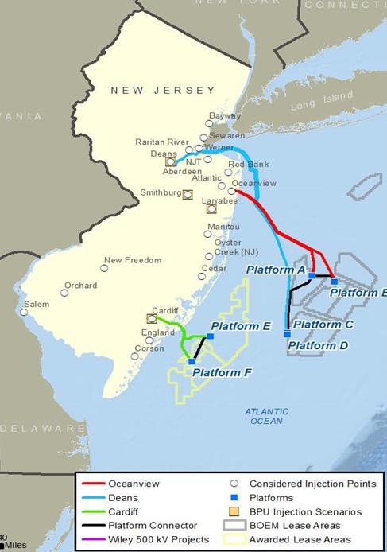
Key environmental considerations in the design and choice of transmission
solutions
Provide the most benefits possible
Maximize the amount of offshore wind while minimizing environmental impacts and costs to customers
Examples include: HVDC provides better electrical performance with fewer/smaller cable impacts, reducing seabed impacts and requiring fewer onshore landings
Minimizes environmental impacts
Mitigates permitting risks
Choosing a solution that has fewer environmental impacts reduces future permitting risks
Proprietary & Confidential

Slide 38
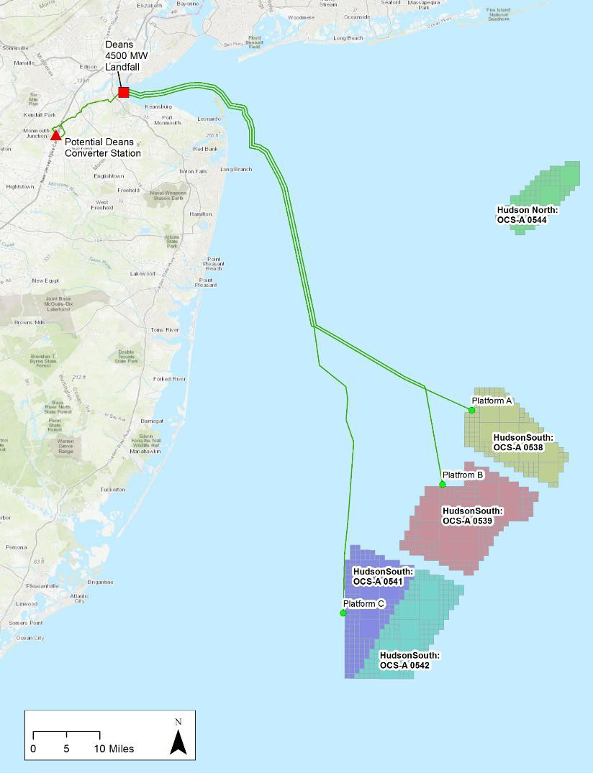
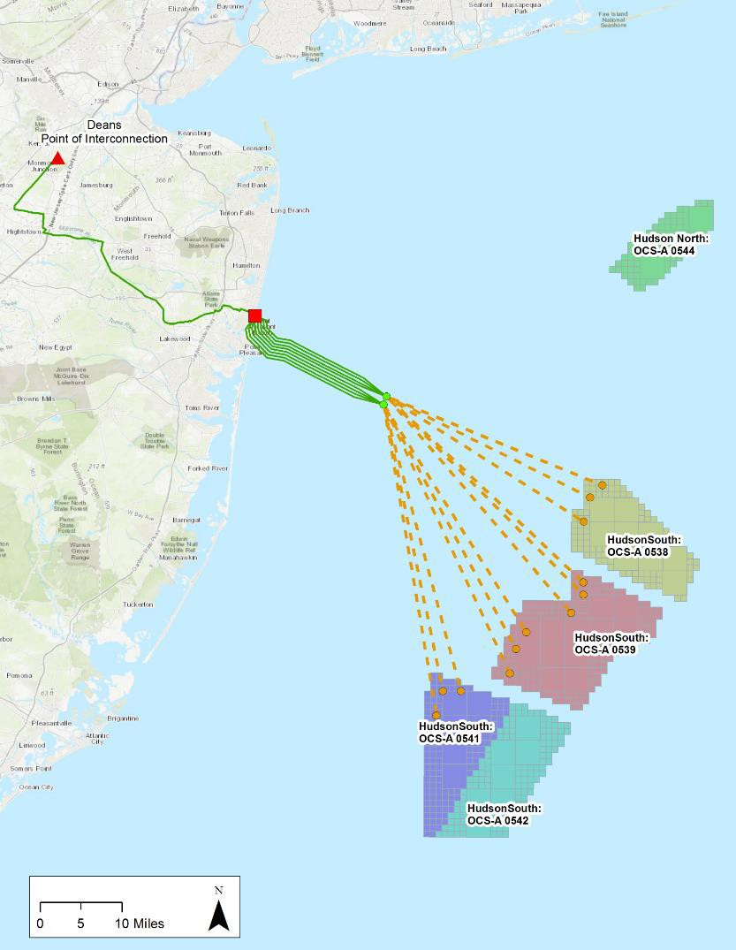
How the offshore wind connects is a key consideration in minimizing
environmental impacts
Benefits of Design
Locating a collector station closer to shore increases platforms and cables in the ocean
A design that extends to the lease areas will require fewer cables and platforms
More cables and platforms required (AC cables deliver less power per cable)
1) NEETMA estimates based on each developers’ BOEM lease areas and proposed point of interconnection
Proprietary & Confidential

Slide 39
A coordinated transmission approach can be permitted efficiently along with offshore wind development
39

Slide 40
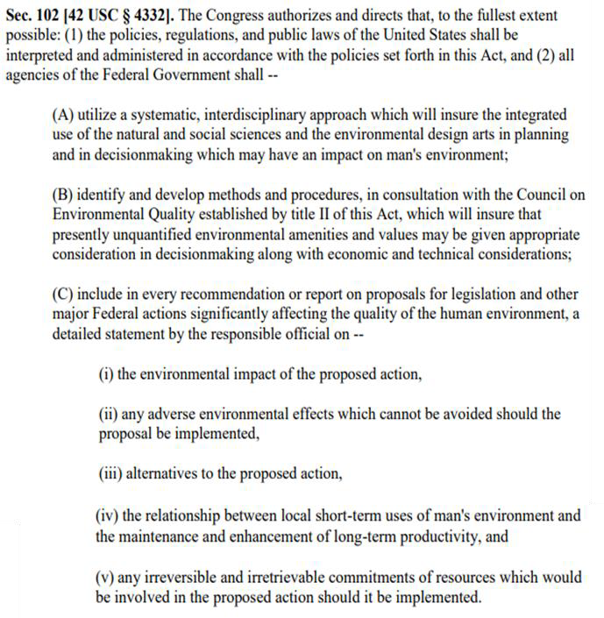
Strong National Environmental Policy Act (NEPA) Analysis leads to better
project outcomes
Reasonable Range of Alternatives – Analysis should include reasonable alternatives to avoid or minimize adverse environmental impacts
Connected Actions/Cumulative Effects – Closely related actions should be included in environmental analysis
Reasonably Foreseeable Effects – BOEM may choose to include ROW impacts from all
offshore wind leases compared with BPU’s
coordinated approach
Tiering - NEPA regulations have long encouraged agencies to tier their environmental analysis
40

Slide 41
BOEM can ensure that permitting a coordinated transmission solution will not
result in delay or “harm” to existing or future wind energy projects
OCS ROW/RUE Transmission Permitting
While OCS transmission alone has less permanent surface occupancy, project specific environmental analysis will likely cover connected actions
BOEMs ability to scope BPUs choice of transmission provider in ongoing NEPA for offshore wind will better enable permitting efficiencies with minimal impact to final project delivery schedules
In situations where a COP may be in process and BPU chooses a different transmission provider, appropriate NEPA (alternative/concurrent/tiered) may adequately provide a permitting path for separate transmission ROW/RUE issuance
Strong coordination between state permitting agencies and BOEM can help streamline
OCS transmission permitting
41

Slide 42
Transmission solutions with the least environmental impacts provide the greatest permitting efficiency
42

Slide 43
Thank You!
43

Slide 44
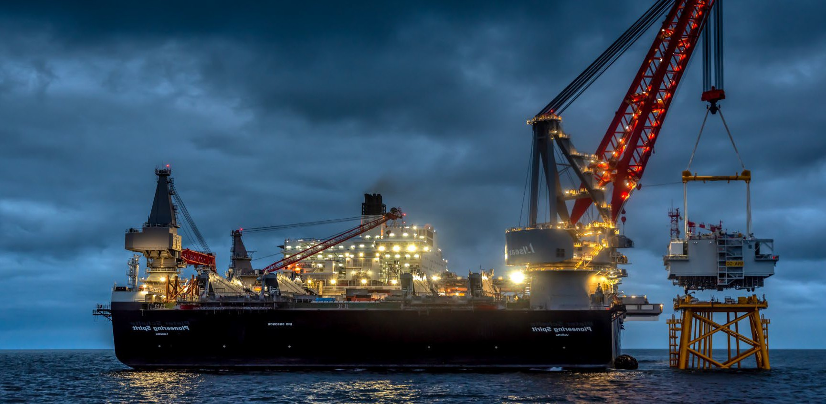
Mid-Atlantic Offshore Development, LLC
Environmental and Permitting Issues
NJ BPU Stakeholder Meeting #3
April 4, 2022

Slide 45
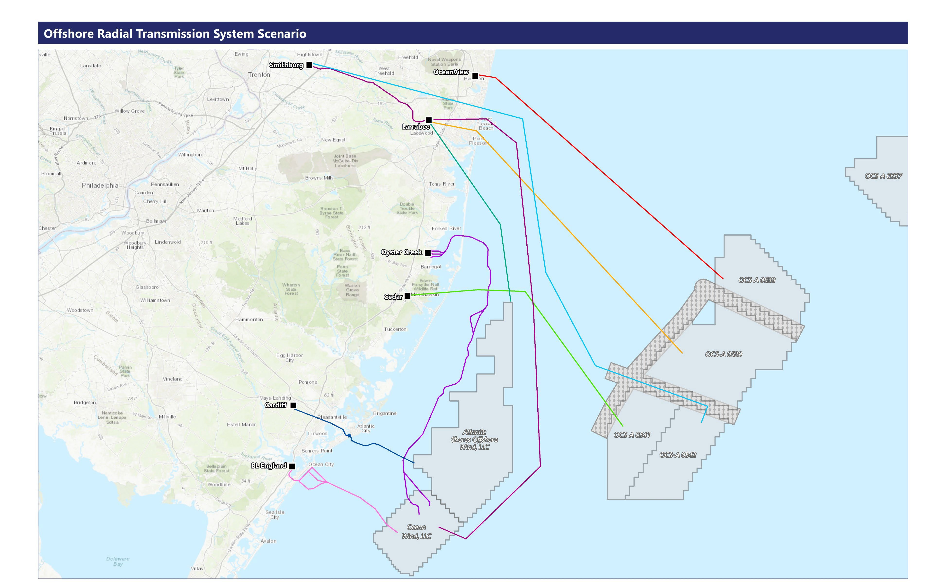
Hypothetical Offshore Wind Radial Transmission

Slide 46
Advantages of a Coordinated Transmission Solution
Minimizes the overall footprint (impact) – offshore and onshore
Reduces cumulative impacts from multiple, independent projects
Decreases conflicts and addresses stakeholder concerns

Slide 47
Achieving Environmental Benefits – Overcoming Issues
Submarine cables from multiple windfarms in one offshore corridor
One, carefully site landfall location
Onshore, underground system located in previously disturbed areas

Slide 48
Locate Onshore Facilities to Avoid Impacts
Avoid impacts to the shoreline – tunnel under beach and dunes
Avoid wetlands, streams and floodplains
Avoid documented barred owl and other protected bird habitats
Underground installation; no new structures or overhead wires

Slide 49
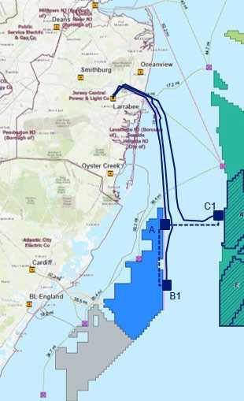
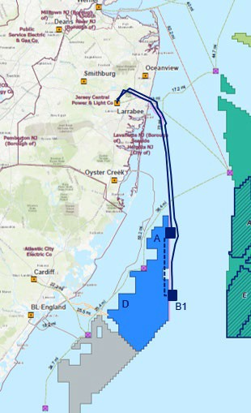
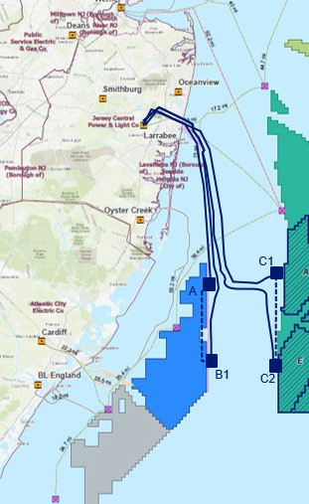
MAOD Proposal Overview
For Illustrative Purposes, not to scale
MAOD HVDC Line
MAOD Interlinks
2021-NJOSW-431
2021-NJOSW-551
2021-NJOSW-321
Proposal 1 - 2400 MW
2x 1200 MW HVDC to JCP&L (Larrabee, Smithburg or Atlantic)
Leverages de-risked corridors onshore and offshore to support awarded OREC Solicitation Round 3
Proposal 2 - 3600 MW
3x 1200 MW HVDC to JCP&L (Larrabee, Smithburg, Atlantic)
Additional 1,200 MW to support awarded OREC OSW Solicitation Round 4
Proposal 3 - 4800 MW
4x 1200 MW HVDC to JCP&L (Larrabee, Smithburg, Atlantic)
Additional 1,200 MW to support awarded OREC OSW Solicitation Round 4, 5

Slide 50
Environmental Benefits & Reduction of Impacts
Air quality – Reduction in NO_{x}, CO, and CO₂ - less construction vessels and vehicles
Seafloor conditions and benthic habitat – HVDC technology and routing cables in one corridor that has been properly sited
Neighborhoods and beaches – Landfall and onshore cable routes carefully sited to minimize impacts
Navigational safety – Less vessel traffic, bury cables in one corridor
Commercial and recreational fishing – avoid reefs and fishing areas, fewer conflicts

Slide 51
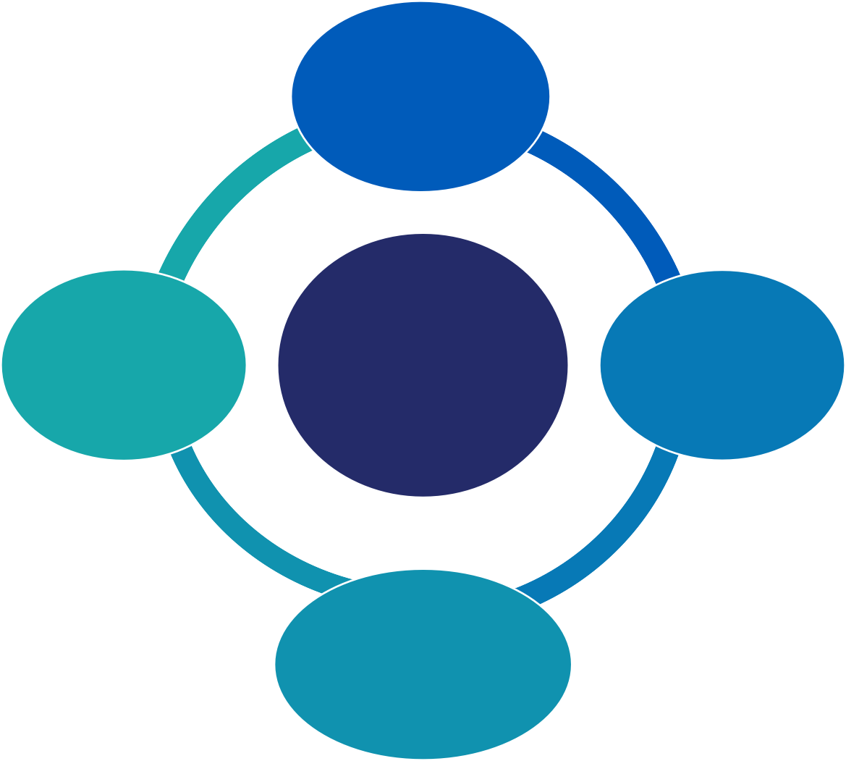
MAOD Actions Led by Values and Goals
Serving the future expansion of offshore wind
Protecting New Jersey’s unique coastal and marine environment
Reducing environmental impacts
Mitigating environmental impacts
Environmental stewardship
MAOD
Environmental Protection Values
Leading with science & data
Collaboration with strong partners
Open, regular, & inclusive communication

Slide 52
Thank you for your time and attention
Questions, please?

Slide 53
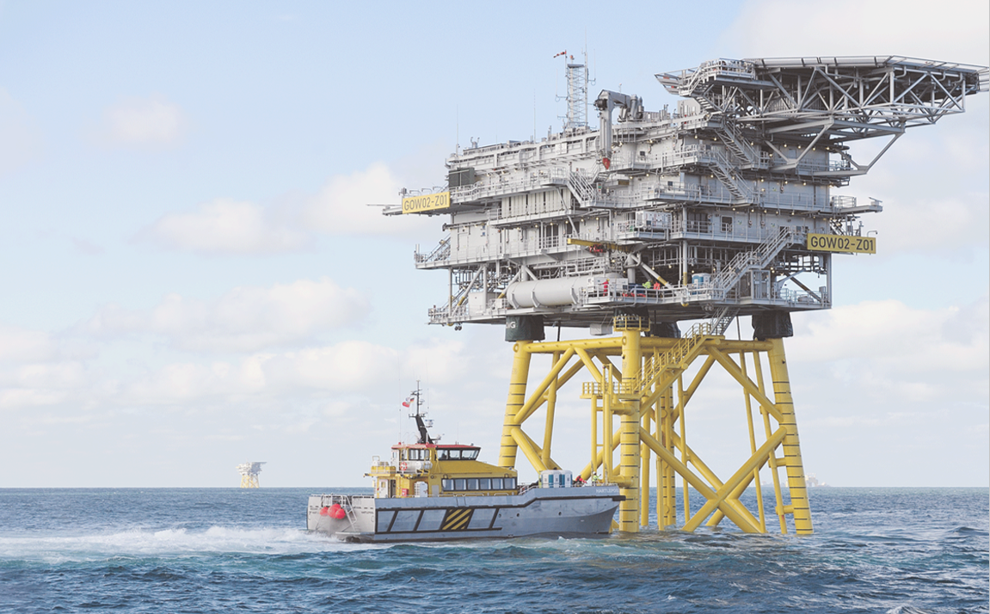
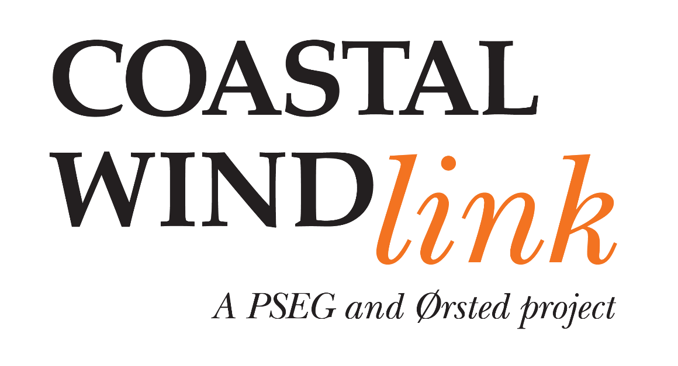
April 4, 2022

Slide 54
PSEG’s New Jersey Electric Permits
With our decades-long permitting experience, Coastal Wind Link brings the most qualified team to the permitting process
PSEG/Ørsted team are working together on Ocean Wind 1 (COP approval scheduled for June 2023)
Ørsted owns and operates Block Island Wind Farm, America’s first offshore wind farm
Ørsted and Eversource’s South Fork Wind Project received COP approval in January 2022
Ørsted has six other contracted Wind projects in the U.S. with Federal and State permitting underway
PSEG operates and maintains 1,200 miles of overhead and over 300 miles of underground electric transmission in NJ
Electric Transmission and Distribution Number of Permits
668
619
2021 Breakdown
683
727
747
2017
2018
2019
2020
2021
Total
Municipal
County
Regional
Federal/State

Slide 55
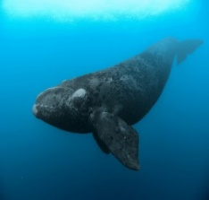
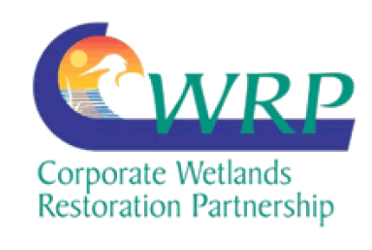
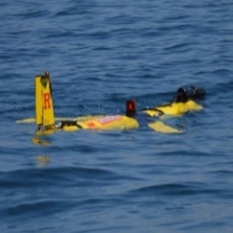
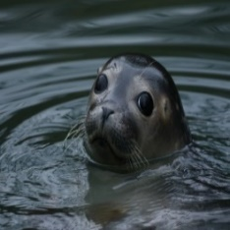
PSEG and Ørsted are committed to biodiversity and environmental stewardship
Integrated Vegetation Management along 1,200 miles of transmission rights-of-way to promote sustainable meadow habitat, vital to declining grassland birds and pollinators.
Designed and constructed a nesting platform for bald eagles. A nest cam was also installed where the public can watch the eagle activities live.
Active participation in Monarch Butterfly Conservation Agreement for Energy & Transportation Lands, with the United States Fish and Wildlife Service and the Energy Resources.
Committed over $7 million to Atlantic Right Whale and marine mammal research.
Estuary Enhancement Program, which has restored thousands of acres of marshlands in southern New Jersey and neighboring areas along the Delaware Bay.
Helped form New Jersey Corporate Wetlands Restoration Partnership, a public-private initiative aimed at restoring, preserving, enhancing, and protecting aquatic habitats throughout NJ. Chaired the Partnership since its inception.
ECO-PAM monitoring project in partnership with Rutgers University, University of Rhode Island and the Woods-Hole Oceanographic Institute (WHOI).
Seal tagging studies with Stockton University and AMSEAS.
We have a proven record of protecting New Jersey’s environmentally sensitive areas and have deep, well-established roots with New Jersey’s environmental community

Slide 56
Coastal Wind Link: The most committed project to New Jersey’s environmental sustainability and enhancement
Onshore benefits
Focused routing in streets and already disturbed areas
Leverages existing “brownfield sites” to limit cost and environmental disturbance
Minimizes the transmission system footprint on land
Longstanding relationships with state, regional, county & local agencies
Avoidance
Minimizes disturbance to wetlands via innovative technologies
Avoids Green Acres and Designated Open Space Locations
Avoids Prime Fishing Areas in OSP siting
Avoids Army Corps Borrow Areas used for beach re-nourishment
Responsible siting
Maximizes efficient connections to wind turbine generators
Minimizes the transmission system footprint on the marine environment
Limits potential impacts to fisheries and other marine resources
Avoids conflicts with shipping, commercial fishing, and existing submarine infrastructure
Offshore benefits
Limits number of cables needed to bring power to shore
Able to service multiple lease areas
Redundancy options to limit down time for renewable generation
In-house, dedicated Marine Affairs team for engagement with mariners and fisheries stakeholders

Slide 57
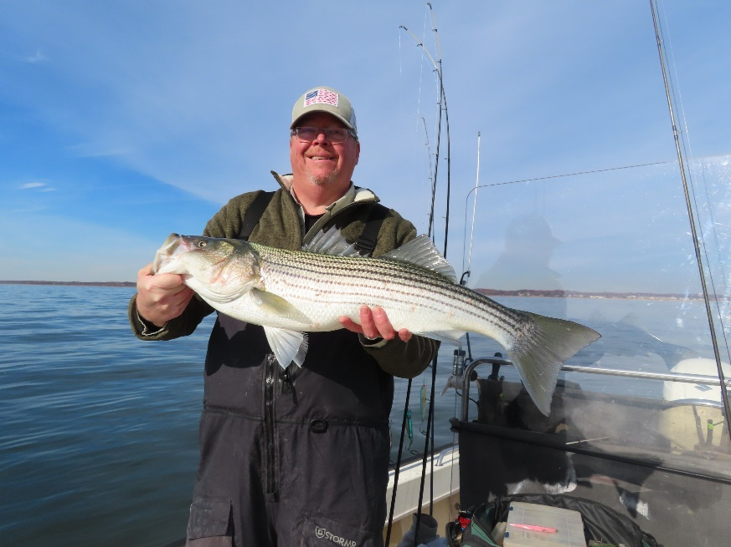
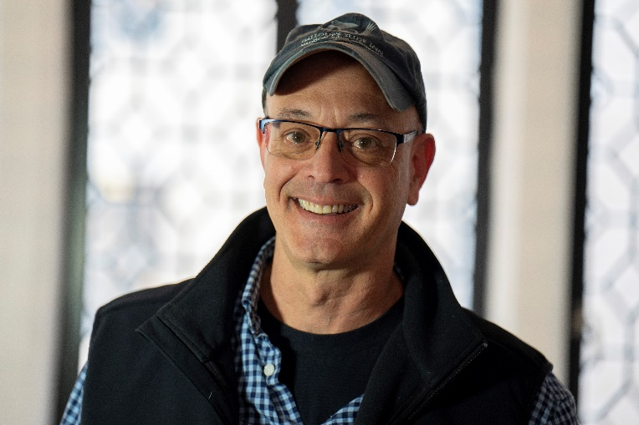
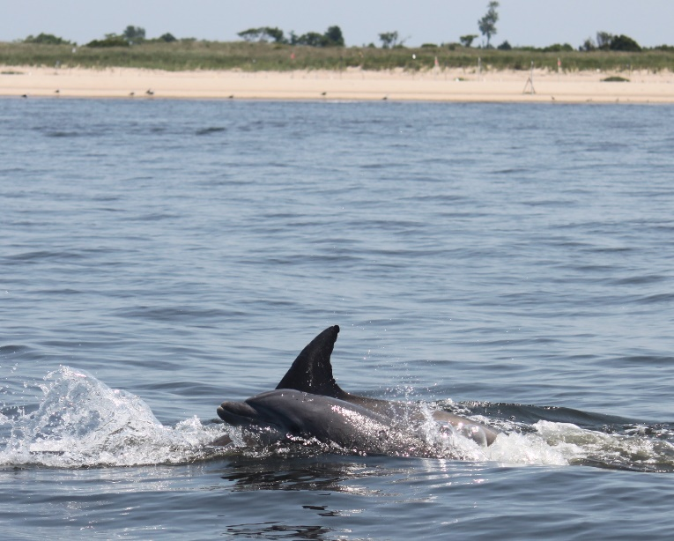
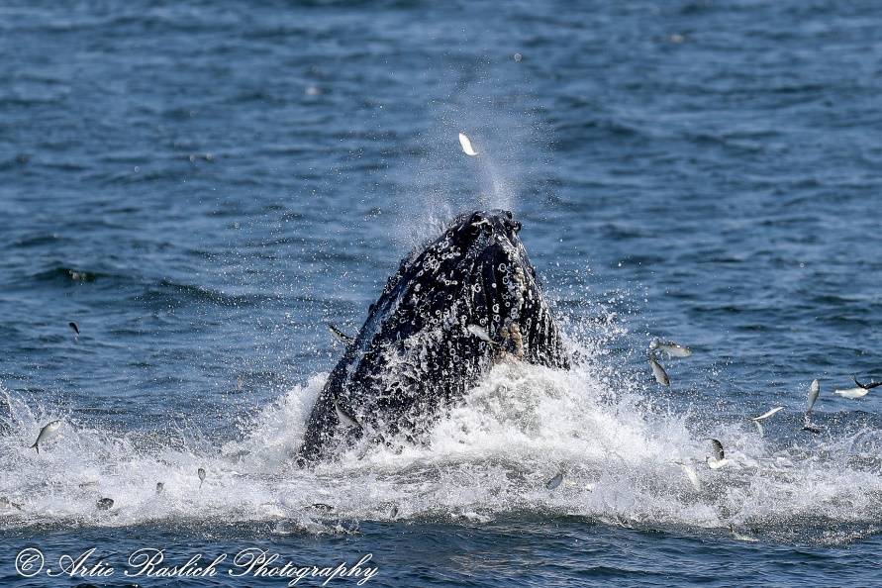
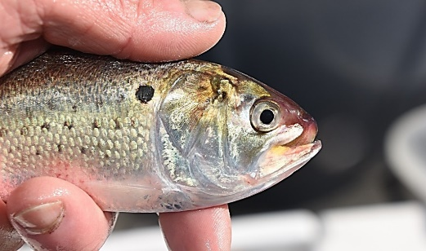
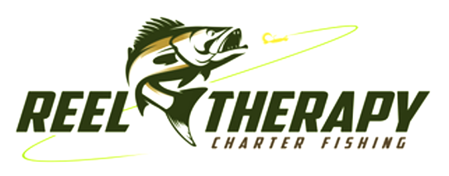
Capt. Paul Eidman
Owner/operator of Reel Therapy Fishing Charters, Tinton Falls NJ Offering Fishing charters, whale and dolphin watching trips
4th generation recreational angler
Based out of Raritan Bay/NYNJ Bight fishing locally for 30 years
Holds a U.S.C.G. 100-ton Merchant Mariner License
Decades of experience in marine fish conservation work with Atlantic menhaden, river herring and fish passage and essential habitat restoration

Slide 58
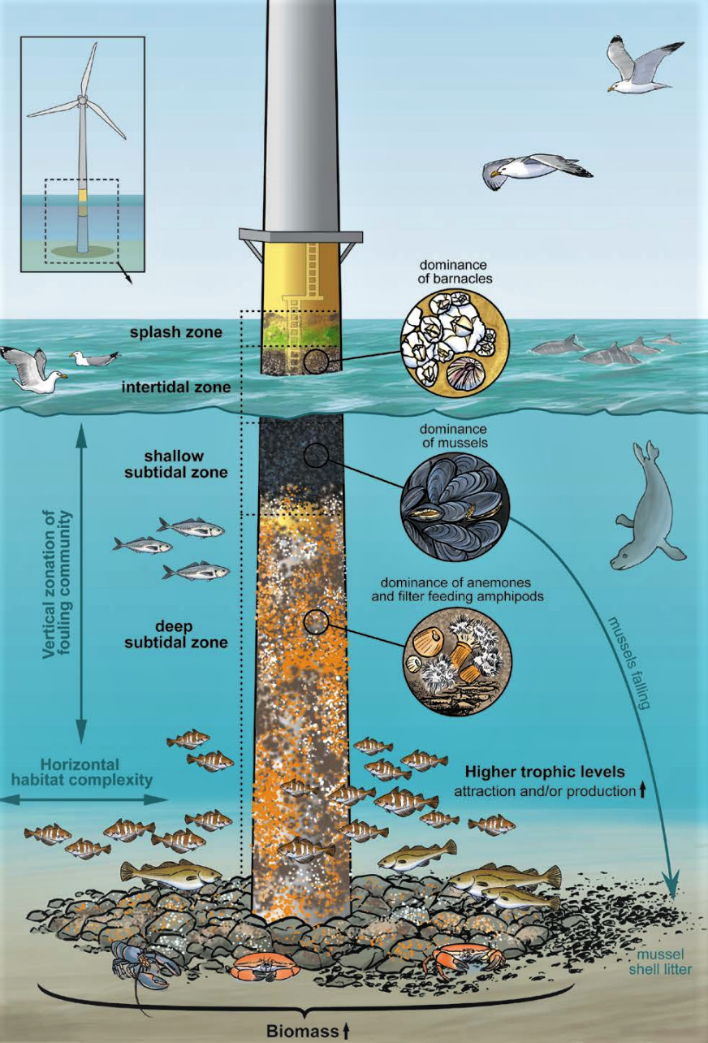
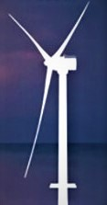
I became an advocate for offshore wind power because I feel that it can help us :
Transition towards 100% renewable energy
Stop fossil fuels from polluting our waters and air
Reduce ocean acidification
Stall climate change, reduce storm intensity
Keep our gamefish in our waters, stall migration northward
Create offshore habitat for the ecosystem and increase fishing opportunities
Create maritime and land-based jobs for years to come

Slide 59
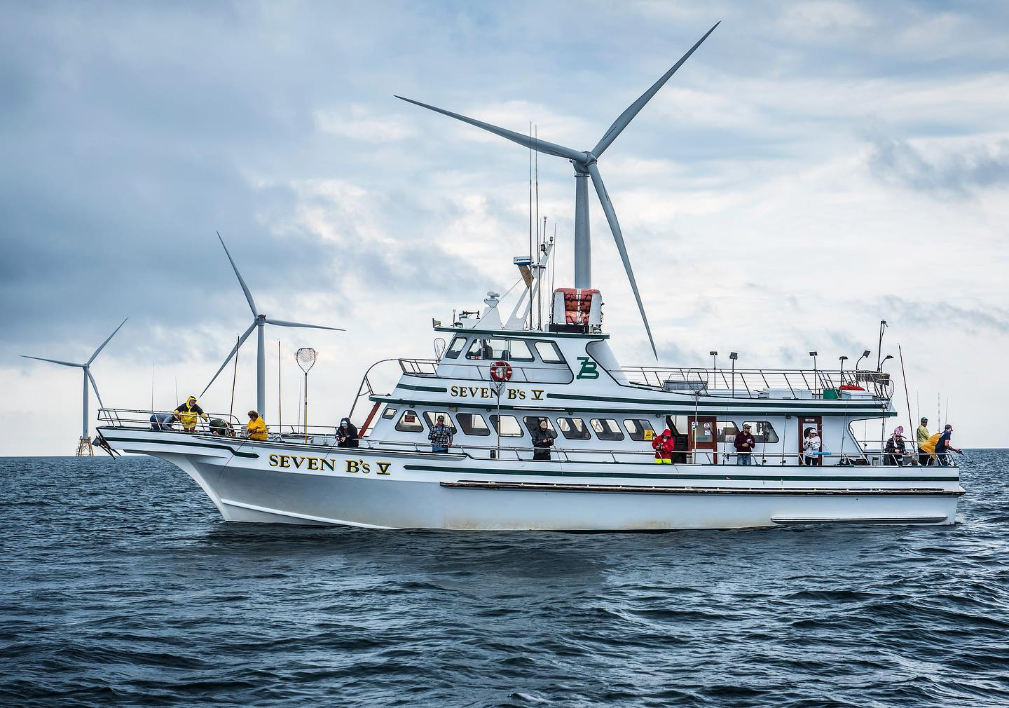
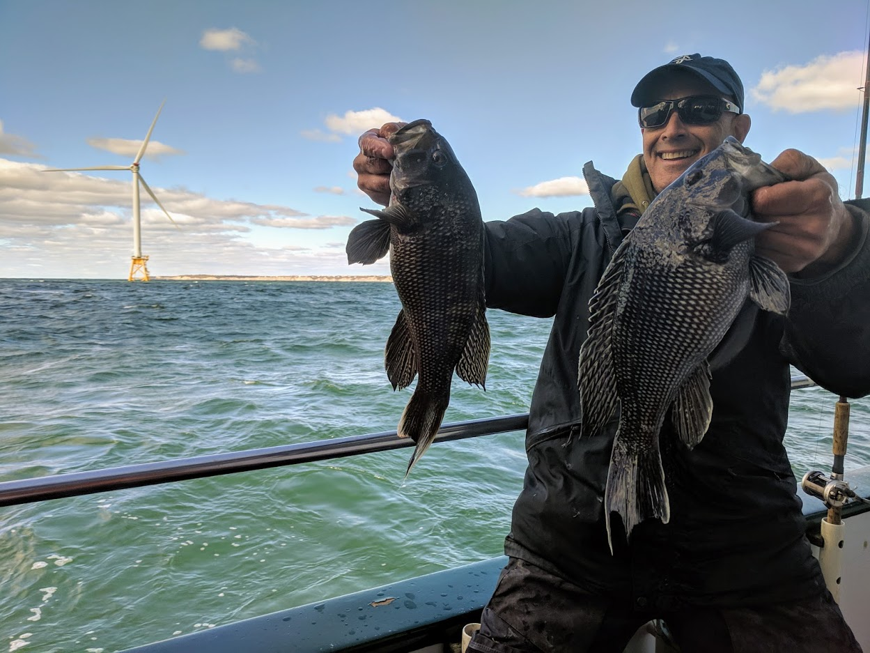
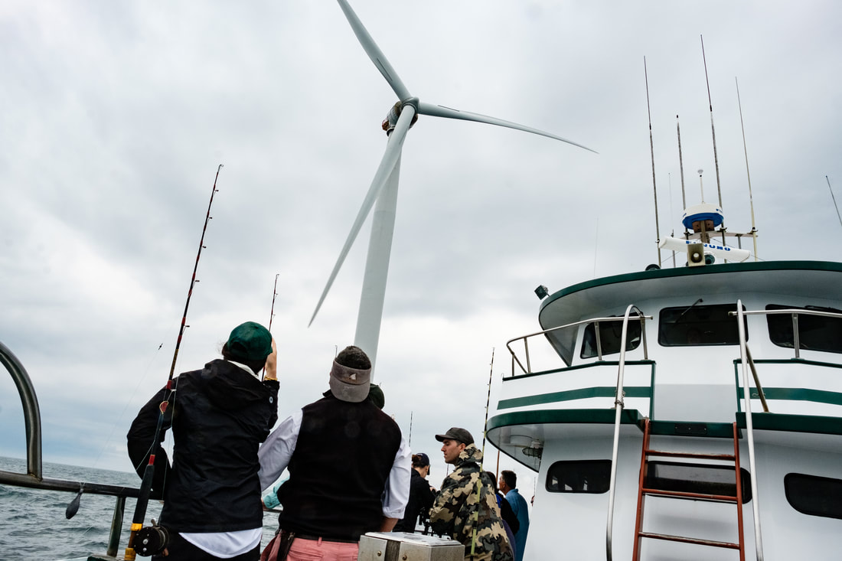
I have fished at the Block Island Wind Farm and have witnessed firsthand not only the great fishing but the effects that the wind farm has had on fishing and tourism industries in Block Island and Pt. Judith, Rhode Island

Slide 60
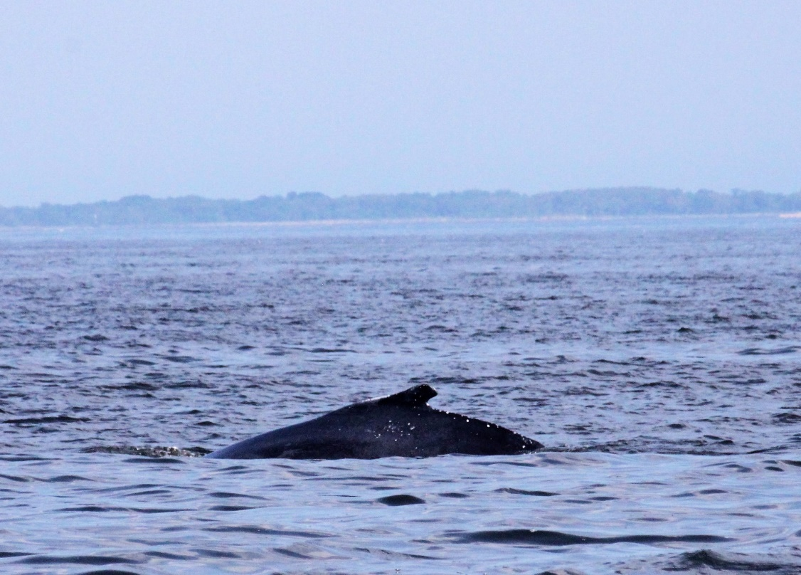
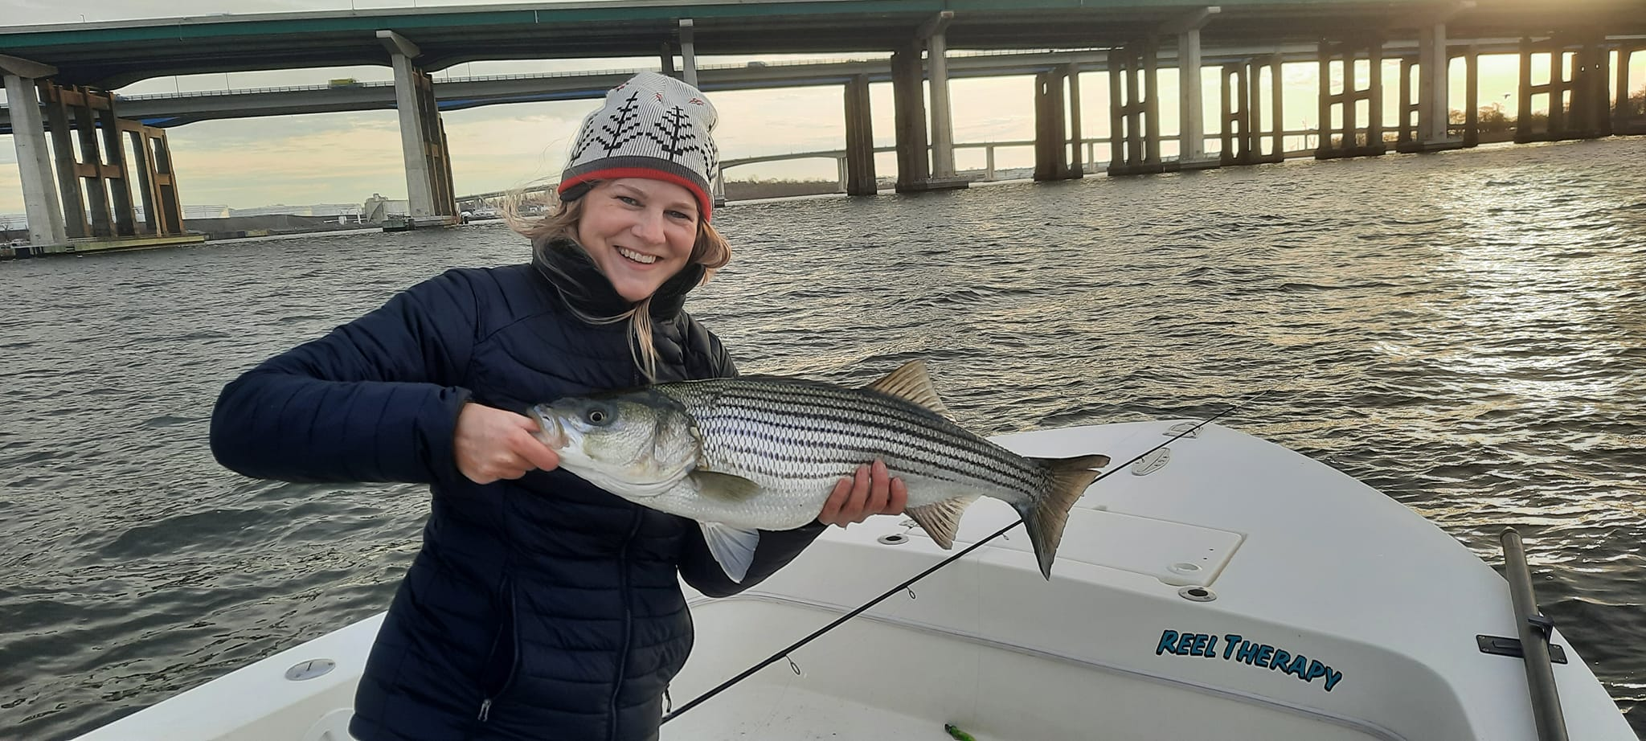
Few local fishermen realize that we have been fishing directly on top of the Neptune Cable which has been operating in the center of Raritan Bay since 2007
This cable is high voltage, carrying 500 kv of power from Sayreville to Jones Beach, Long Island and has not affected the fishing or migration patterns at all.
We successfully fish directly over the energized cable for summer flounder, striped bass and bluefish
I see often see whales, turtles, dolphin and sturgeon in the same area.

Slide 61
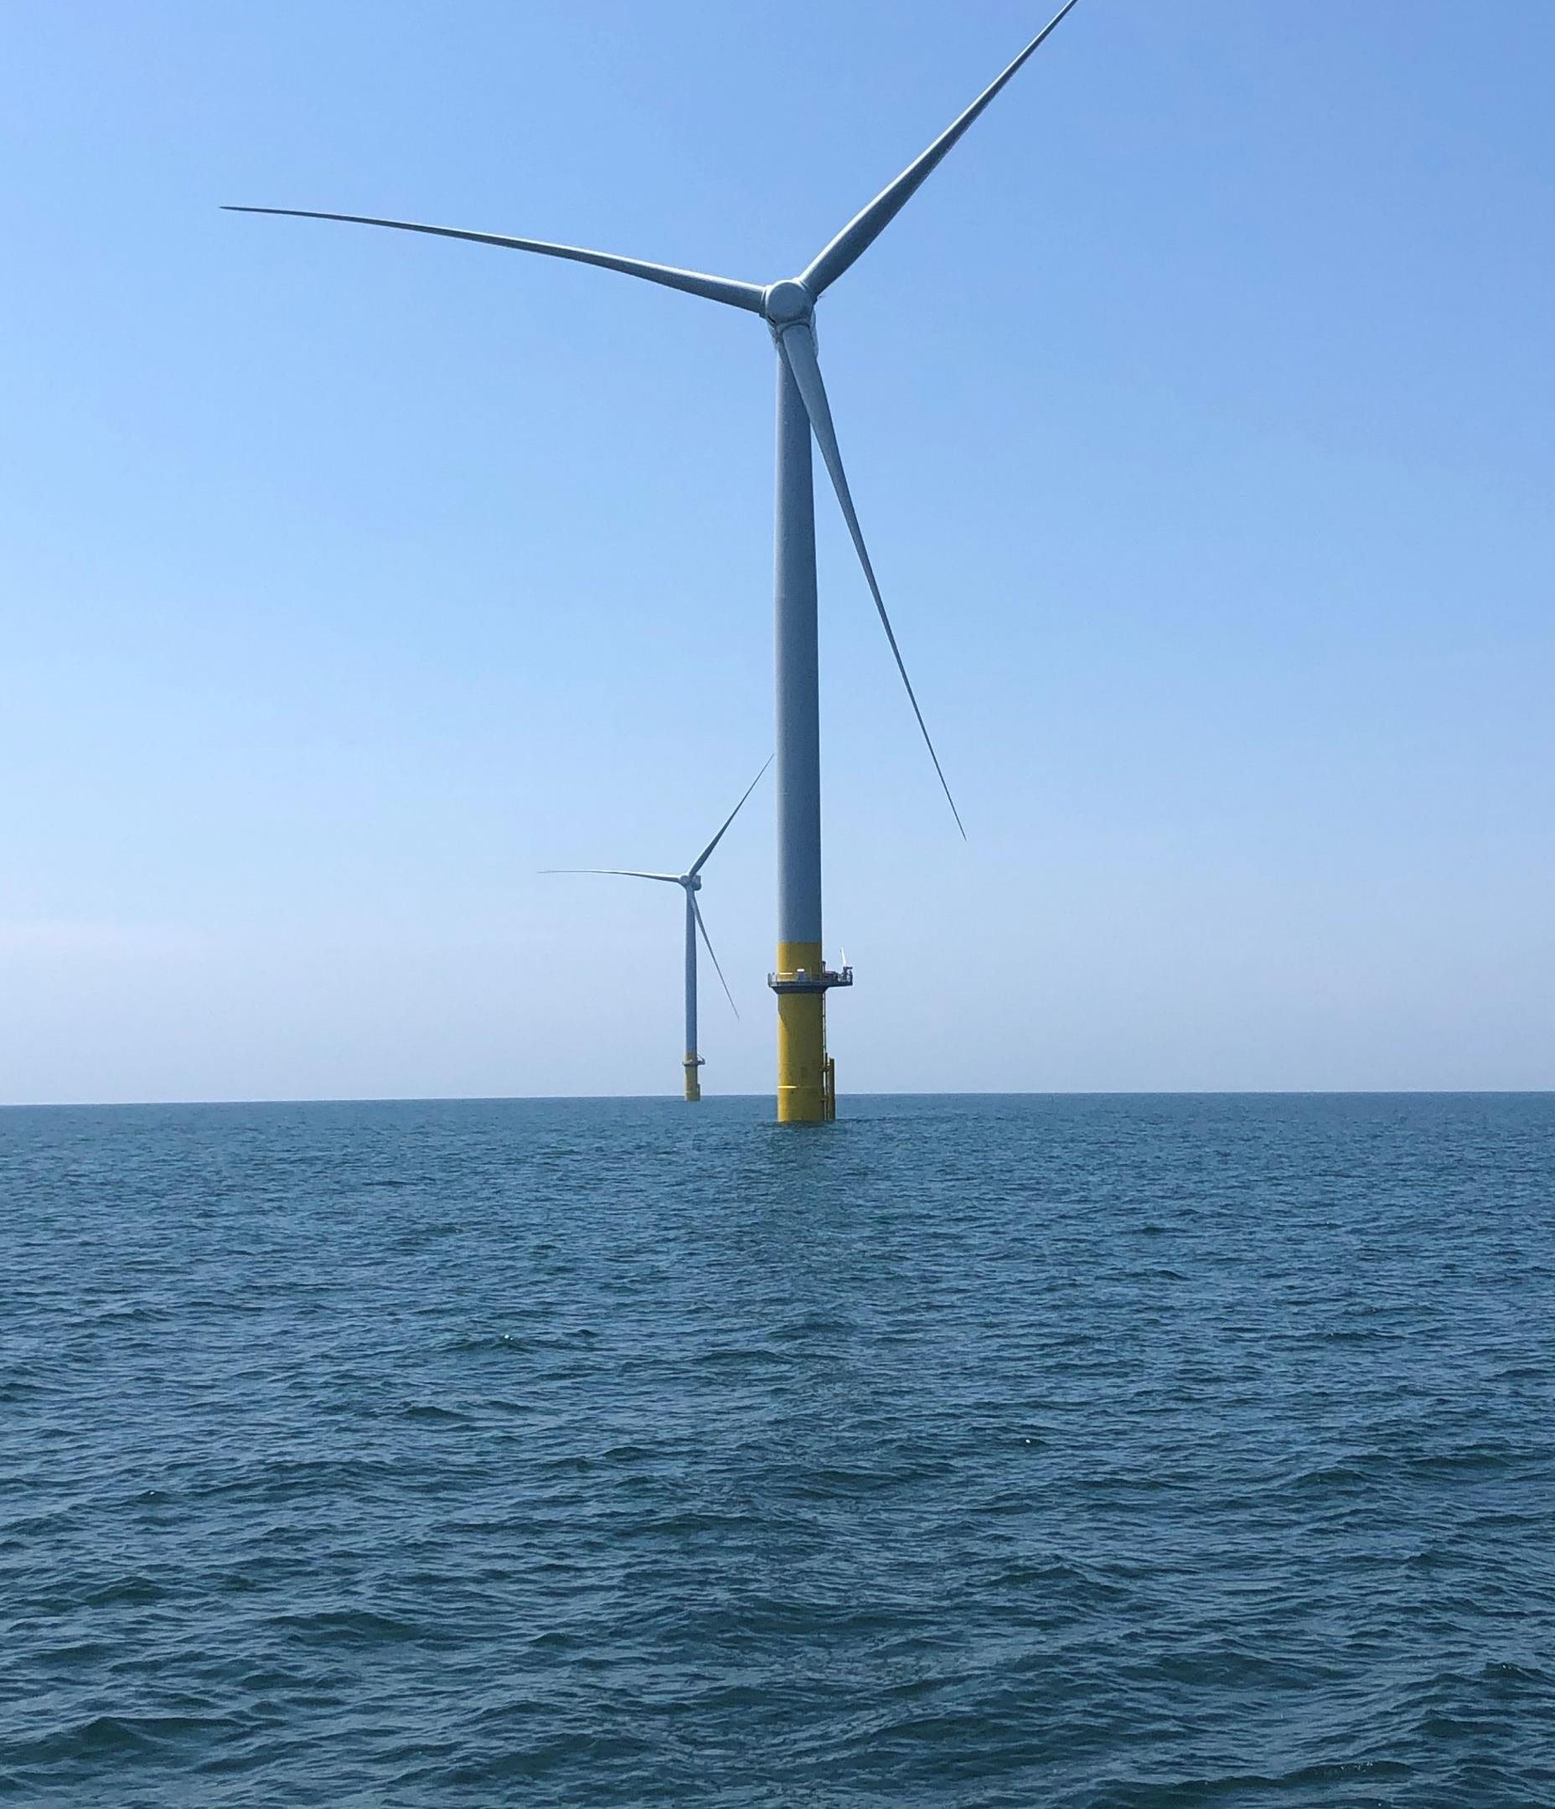
As a New Jersey fisherman and small business owner here in New Jersey, I am relying upon the NJBPU to do this project right. That means BPU will:
Recognize that one approach is not always best regarding all landing sites and cable routes. I’m hopeful that you will choose the best option(s) with environmental impacts and cost to rate payers in mind.
Ensure that all proposed cable landing sites are supported by studies showing cable corridors that are environmentally appropriate
Time the cable installation so it does not interfere with fishing and fish migration
Employ mitigation methods to reduce impacts during construction
Utilize horizontal directional drilling methods to go under environmentally sensitive areas
Assure the fishing community that they will allow fishing access to the structures built on the water
Share the data and insights gained during the survey process with fishing and environmental interests
Utilize public right of ways onshore to lessen environmental impacts in communities

Slide 62
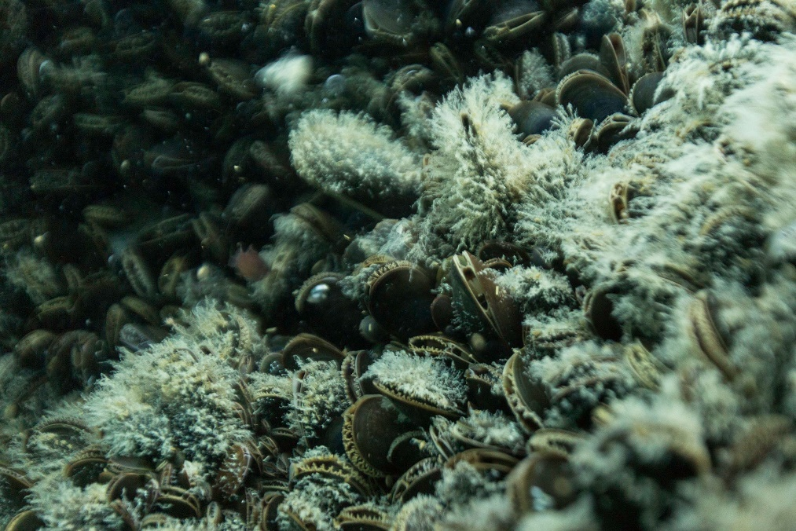
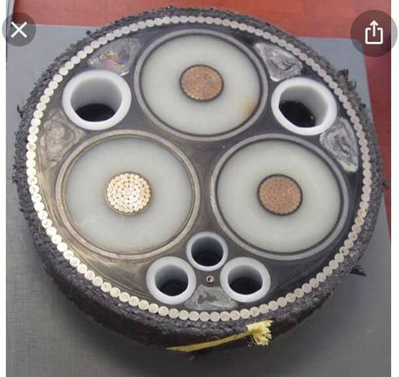
Thank you for the opportunity to share my thoughts about this important project today.
I am hopeful that the NJBPU will continue in a responsible manner and put mother nature first.
paulyfish@reeltherapy.com

Slide 63
NJA On Responsibly Developing Offshore wind
Base Principles for Promoting Responsibly Developed Offshore Wind that Fights Climate Change and Protects Wildlife in NJ
Eric Stiles, President and CEO
NJ Audubon
NJBPU – State Agreement Approach
Environmental and Permitting Issues
April 4, 2022

Slide 64
Climate change is the greatest threat to fish and wildlife
New Jersey could lose up to 2/3 of all fish and wildlife if no action = ecological collapse
Threatens to destroy NJ’s $18.9 bn outdoor recreation economy
Immediate call for action including the rapid development of non carbon emitting energy production
Have your cake and eat it to – it’s all about siting and design

Slide 65
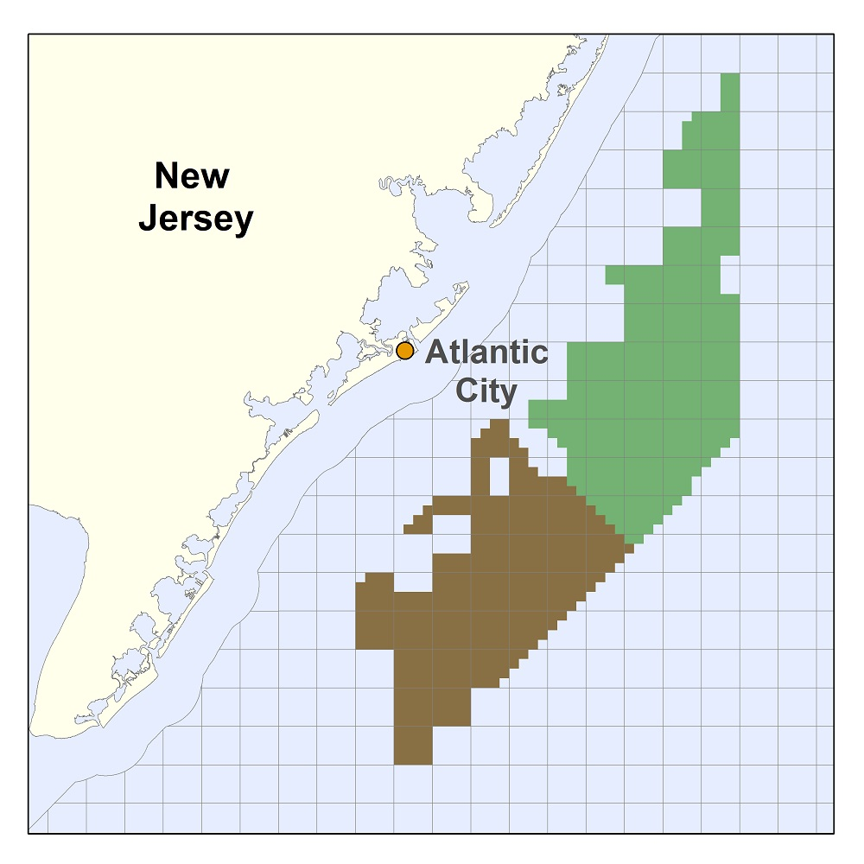
New Jersey as a leader
NJ is a national leader in responsibly developing offshore wind
Over 3700MW have been awarded to two companies (3 projects)
Wind projects selected by BPU have high wind yield AND minimize environmental harm through siting location
Making major investments in ports and workforce development
Notes:
80Proposals submitted by:

Slide 66
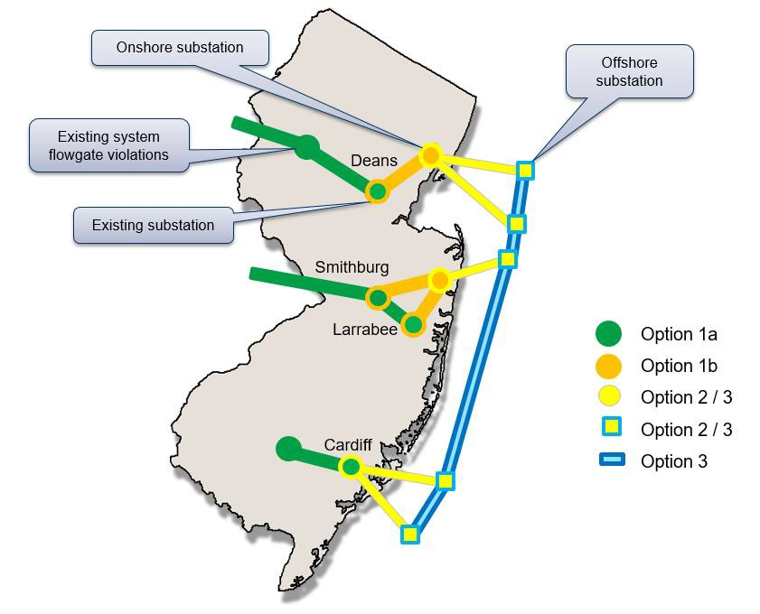
New Jersey transmission roadmap
We thank BPU for its deliberate approach to offshore transmission
Transmission if not done properly could have significant impacts to fish and wildlife including direct effects such as mortality and indirect such as habitat loss. The SAA proposal options (below) minimize this harm.

Slide 67
Environmental & Fisheries Impacts
NOAA charts for context
BOEM GIS shows many existing cables, mostly transatlantic telecom
Cables do not cross sensitive barrier islands
Habitat areas of particular concern are vulnerable to degradation
Future proofing to avoid multiple construction efforts
17
Notes:
This slide from Levitan & Associates, Inc at Feb 26, 2021 presentation to BPU on Transmission. https://www.nj.gov/bpu/pdf/publicnotice/2.26%20OSW%20Presentation%20Final.pdf
Point here is that there are ALREADY transmission lines coming onshore. Environmental and fisheries impacts were evaluated for these at the time of construction. Offshore wind transmission lines must undergo same level of environmental scrutiny to ensure avoidance is achieved. Minimize number of additional cables coming onshore – that is what the BPU/PJM State Agreement Approach is doing.

Slide 68
Factors for responsible onshore cabling
Design should first avoid impact
Then, minimize impact where avoidance not possible
Mitigate once options for avoidance and minimization are exhausted
Avoid sensitive natural resource areas and prioritize already developed sites
Minimize number of cables including onshore
Tie into existing terrestrial infrastructure

Slide 69
Proposal review considerations
Proposal adheres to hierarchy of avoid, minimize and mitigate
Applicant qualifications
Proven track record in NJ with commitment to environmental protection and justice
NJBPU and NJDEP have had positive working experience
Track record of working with NJ stakeholders including non-profits, technical experts and community groups
Demonstrated commitment to the people and environment of NJ

Slide 70
Continuing best practices
Ensure monitoring and reporting during and post construction to build agency and public knowledge
Raw data, analysis and reports related to public (e.g. social and environmental) resources are free and easily available to public
Consider cumulative and not just project specific impacts
NJBPU and NJDEP conduct post award assessment to continue improving process

Slide 71
THANK YOU

Slide 72
New Jersey Offshore Wind Transmission State Agreement Approach Environmental and Permitting Issues Break 11:30 – 11:45 pm
In the Matter of Declaring Transmission To Support Offshore Wind a Public Policy of the State of New Jersey
Docket number QO20100630

Slide 73
New Jersey Offshore Wind Transmission State Agreement Approach Environmental and Permitting Issues Public Comment Period
Once we’ve called on all pre-registered speakers, anyone who would like to make comments that did not pre-register to speak will be able ‘raise their hand’ through Zoom and we will call on you. If you’re joining this meeting by phone, you can raise your hand by pressing *9 and you can unmute yourself by pressing *6.
In the Matter of Declaring Transmission To Support Offshore Wind a Public Policy of the State of New Jersey
Docket number QO20100630

